Slide 1
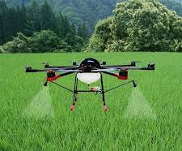
Research Funding by
The Innovation and Entrepreneurship Development Centre (IEDC)
Title of Project: Canopy Detection and Spraying using Agriculture Drone
Amount of Grant: Rs. 1,00,000/-
Objectives:
To carry suitably sized reservoirs, which can be filled with fertilizers, herbicides, or pesticides for crop spraying on large areas in less time.
To reduce the contact of humans with fertilizers, pesticides and other harmful chemicals.
To enhance spraying capacity much faster than with traditional machinery.
To detect sapling using sensors and cameras and work on them while leaving the healthy parts intact.

Slide 2


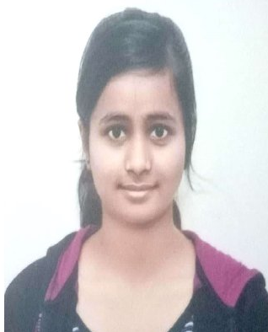
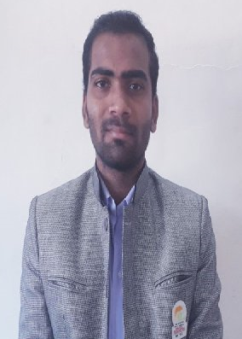
Scholarship received in term of Fee Waiver Scheme by
SWAYAM-NPTEL, IIT Madras
Sr. No. | Name of Students | Name of Course | Scholarship Amount
1. | MUSKAN RAMKUMAR SINGH | Introduction To Japanese Language And Culture | Rs. 500/-
2. | VAIBHAV SANJAY PATIL | Problem Solving through Programming in C | Rs. 500/-
MUSKAN RAMKUMAR SINGH
VAIBHAV SANJAY PATIL

